Slide 1
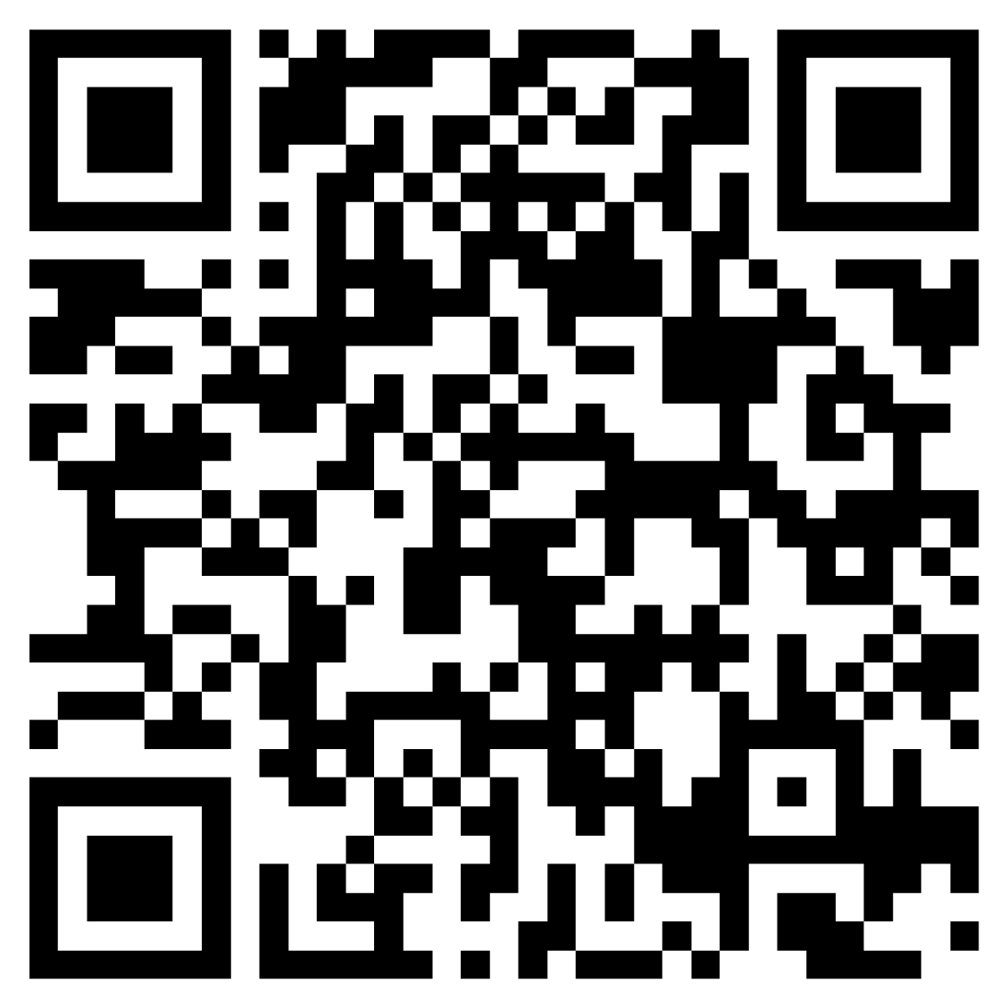
Annual Membership
$199
YOUR PERSONAL SUPPORT SYSTEM TO BECOME A LEADER
WORTH FOLLOWING
using promo code
1Thing
Leadercast NOW is the premier resource for ongoing leadership training and support
Trusted by organizations around the world, Leadercast NOW delivers 1200+ short videos from experts, peers, and the world-famous Leadercast events that will help you make better decisions and become a stronger, more effective leader.
* GET ACCESS TO CONTENT AND RECAPS FROM TODAY’S SPEAKERS
scan now for membership

