Slide 1
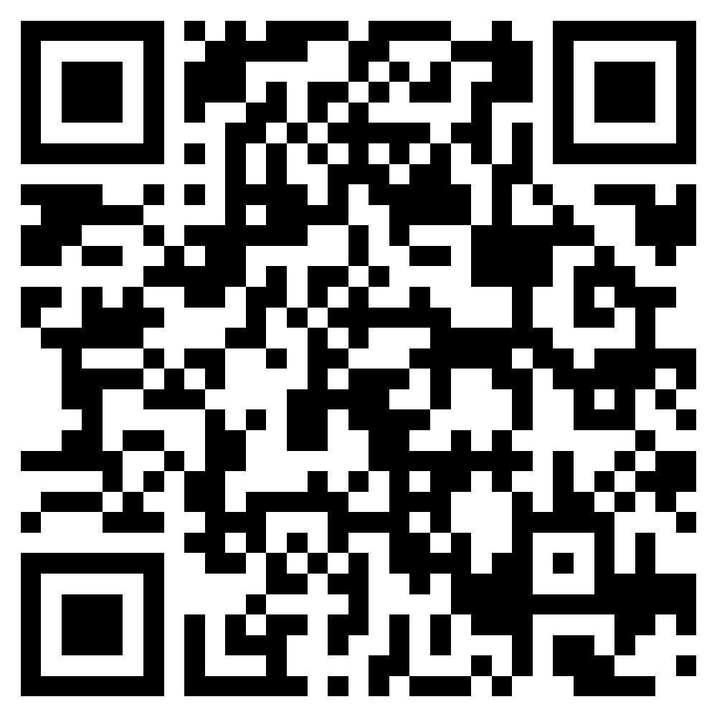
Premier resource for ongoing leadership training and support
Become a stronger, more effective leader
Drive success of your team
Only $199/year
Use promo code 1Thing
Scan now
for membership

