Slide 1
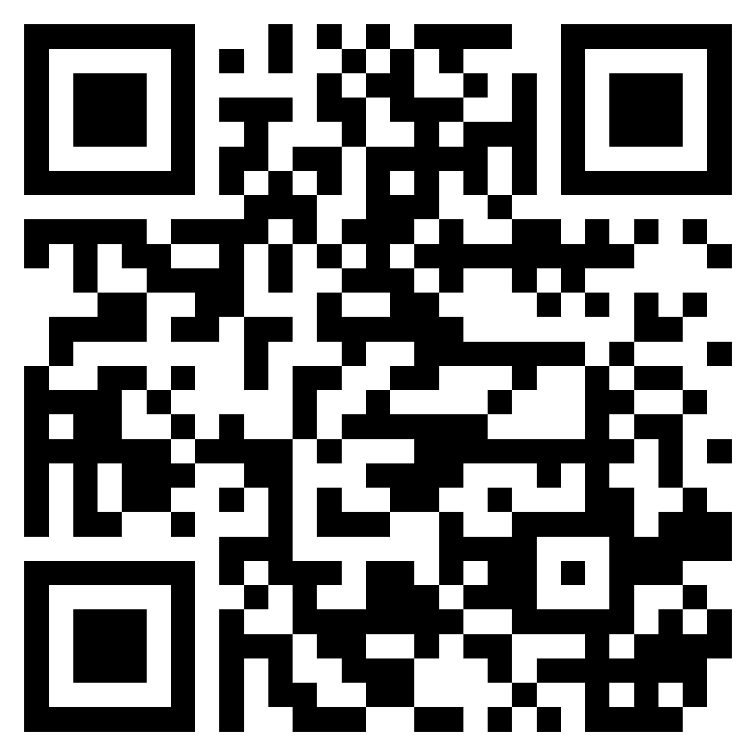
ENROLL TODAY FOR THE COMPLIMENTARY “NEXT STEPS” VIDEO SERIES
scan now
Free 6-week journey of support and continued growth
Exclusive video lessons delivered to your inbox
Continue your Leadercast experience after the event

